Slide 1
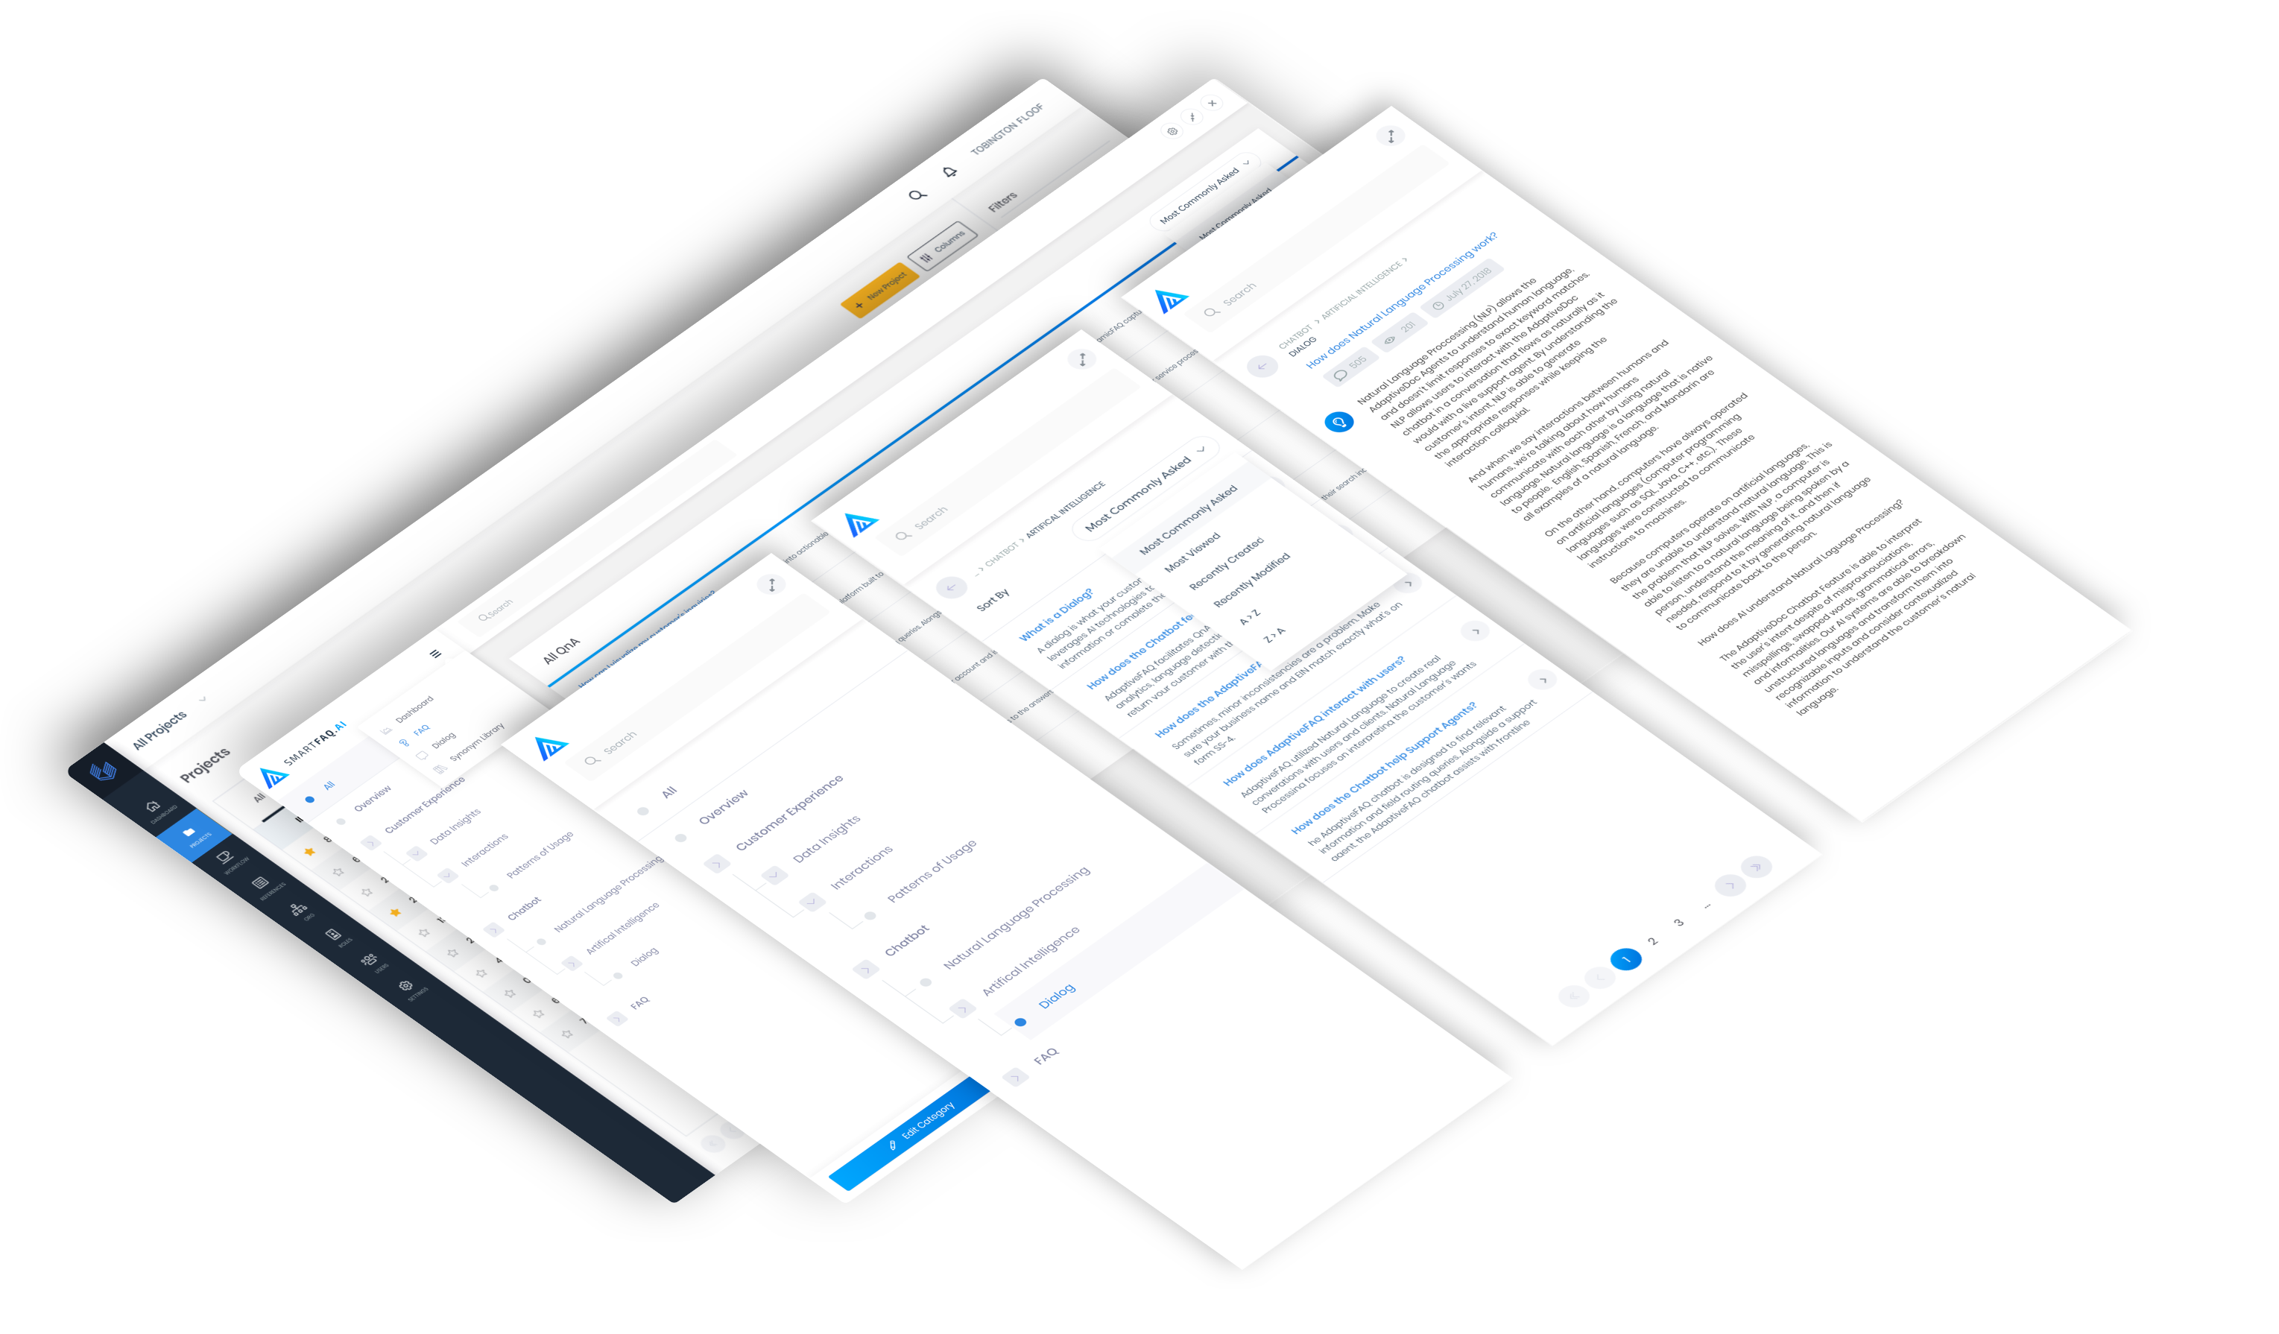
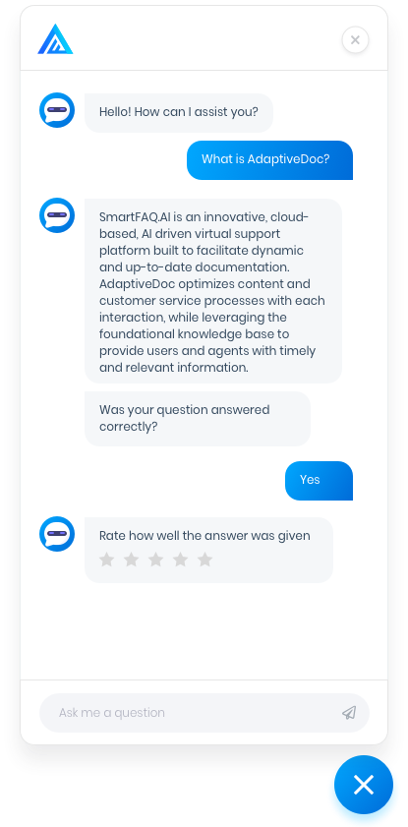

Slide 2
SmartFAQ Overview
SmartFAQ is designed to help businesses better manage their customer relationships. SmartFAQ.AI focuses on the following processes:
Creating and maintaining FAQ/Documentation for software applications. Documentation and FAQ are updated in real time, assisted by Insights into knowledge base gaps and customers’ questions and requests.
Integrated AI chatbot provide 24/7 customer support, using the latest Natural Language Processing and AI Chatbot technologies. Support agents are freed up to focus on more complex and high-value customer interactions.
Facilitating the digital adoption of software products within organizations by greatly enhanced product supports.
Customer interactions are tracked and recorded, providing deep insights into their behaviors and interactions with respect to the underlying software applications. Areas of weakness inside each application (UX/UI, Workflow, Reports etc.) can be easily identified with real-time user feedback.

Slide 3
What makes SmartFAQ unique
among other CRM and Chatbot applications?
OVERVIEW
Can be seamlessly embedded inside any web application or website, with customizable theme to match the supported application.
Supported application knowledgebase (FAQ/Documentation) can be quickly built via an intuitive interface, and is updated in real-time.
AI chatbot is full-featured, using the latest NLP and chatbot technologies.
Transparent integration of the FAQ knowledgebase and AI chatbot dialogs.
LET’S BEGIN!

Slide 4
Chatbot Experience
Q&A search combines textual analytics, language detection, keyword equivalents to return best matched answer
Customized greeting and good-bye messages
Tightly coupled to FAQ/Knowledge base
Full support of NLP (Natural Language Processing)
Support text and voice questions
Multi-language support
Cloud-based, scalable to the largest enterprise organization’s needs

Slide 5
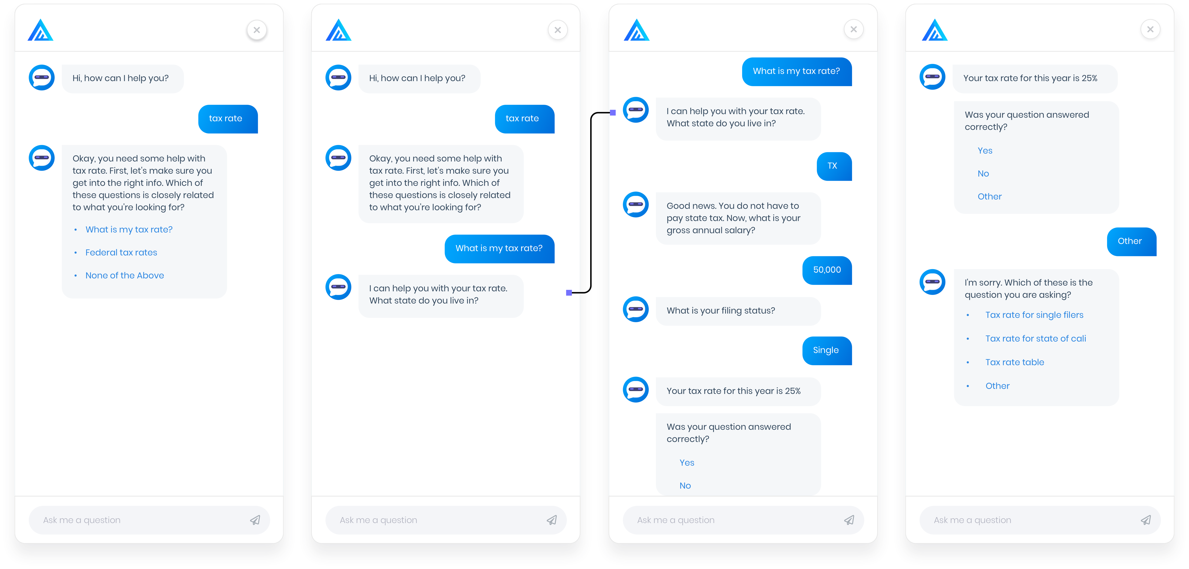

Slide 6
FAQ Experience
An integrated platform of A.I. chatbot and clean application interface to ease the process of creating and maintaining the documentation for a software applications.
Documentation and FAQ are updated in real time, assisted by Insights into knowledge base gaps and customers’ questions and requests.
Seamless integration between search and dialog

Slide 7
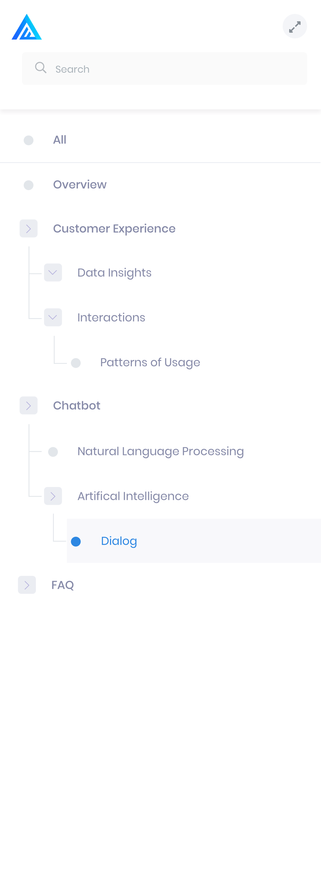
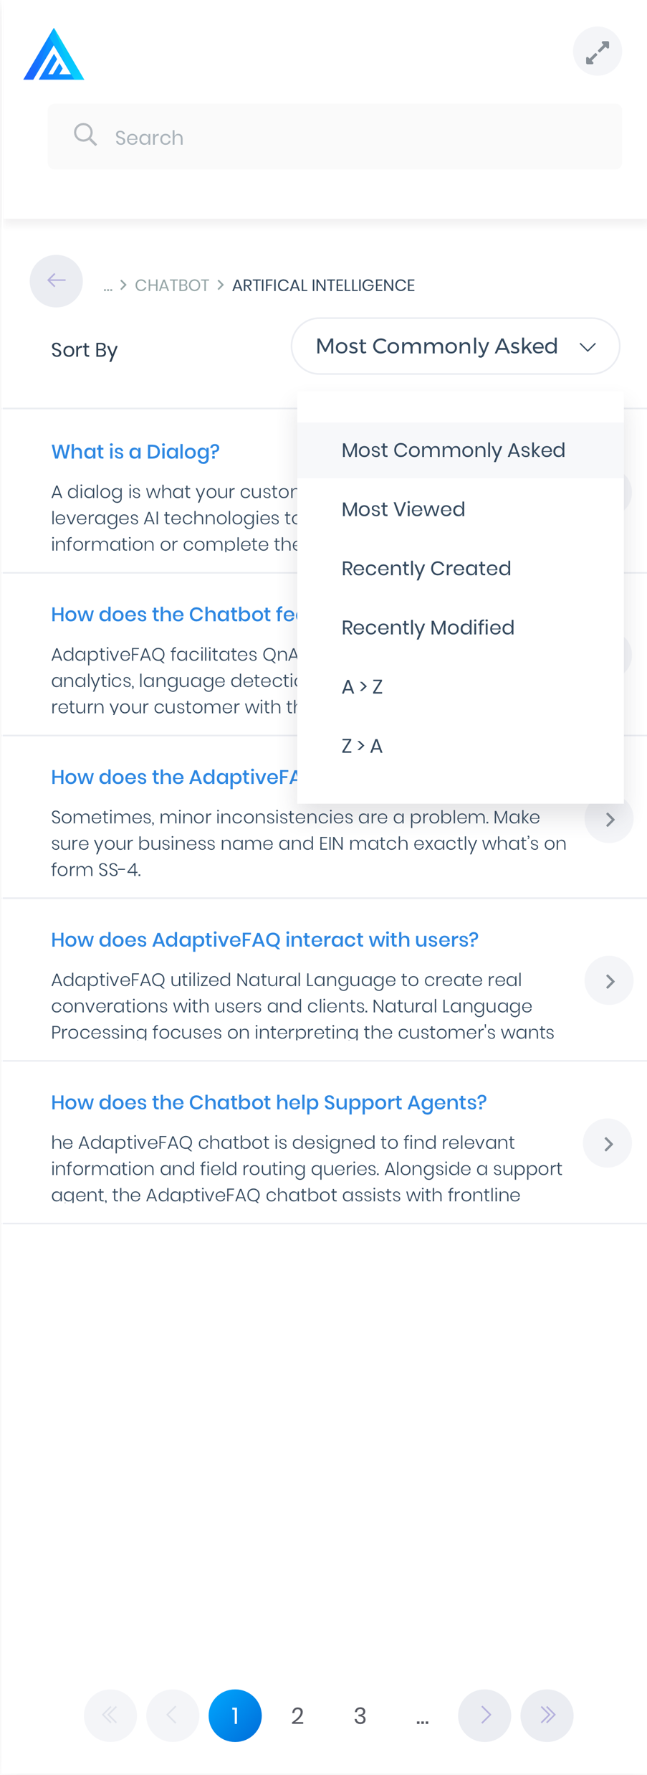
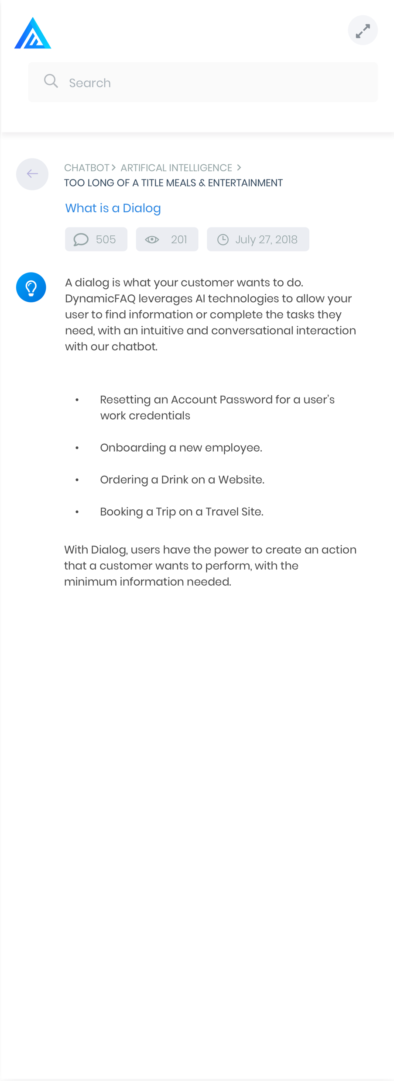
FAQ Experience
Clean interface to create and maintain application knowledge base for documentation/FAQ
SmartFAQ with content updated in real time
FAQ content driven by insights into users’ interactions and demand
Context-sensitive FAQ data presentation based on users’ URL
Actionable Insights into what users ask, their pain points, and intentions

Slide 8
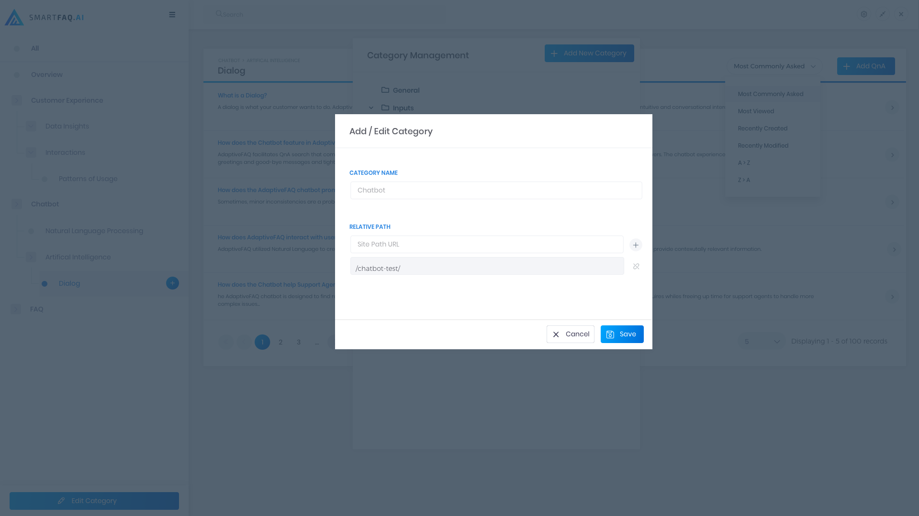
OVERVIEW
Super User can set Sitemap URL
when adding or editing
a category
Sitemap URL will be set based on
the relative path
When the super user navigates to the selected Sitemap URL in browser, the category grid will auto populate and display the QnA based on the path saved

Slide 9
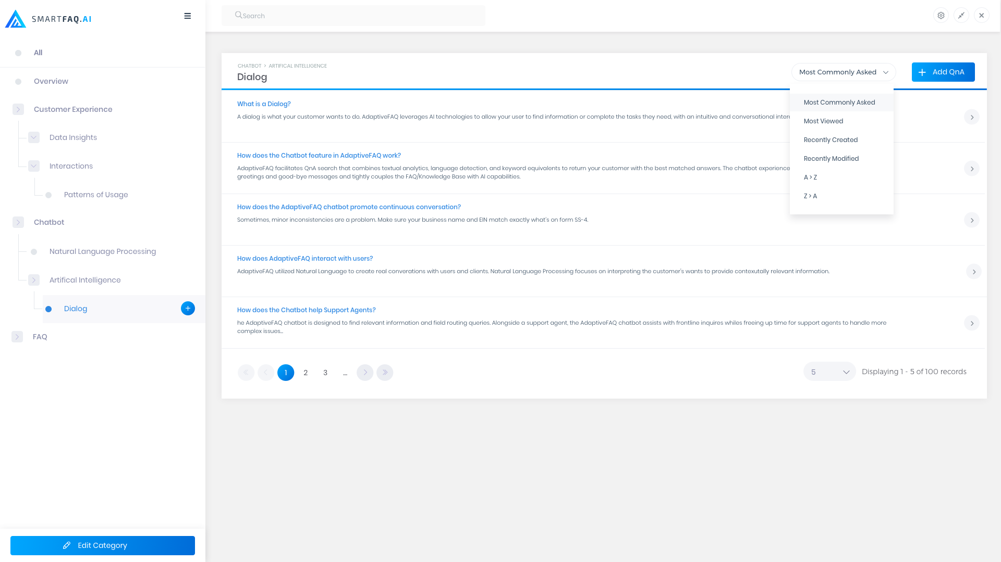
OVERVIEW
User can view the QnA List and
sort the order displayed by selecting a dropdown item
User can navigate throughout the
Category Grid on the left panel
Super user is able to manage the
Categories, add new QnA, edit Existing QnA, and view the
Unanswered Questions.

Slide 10
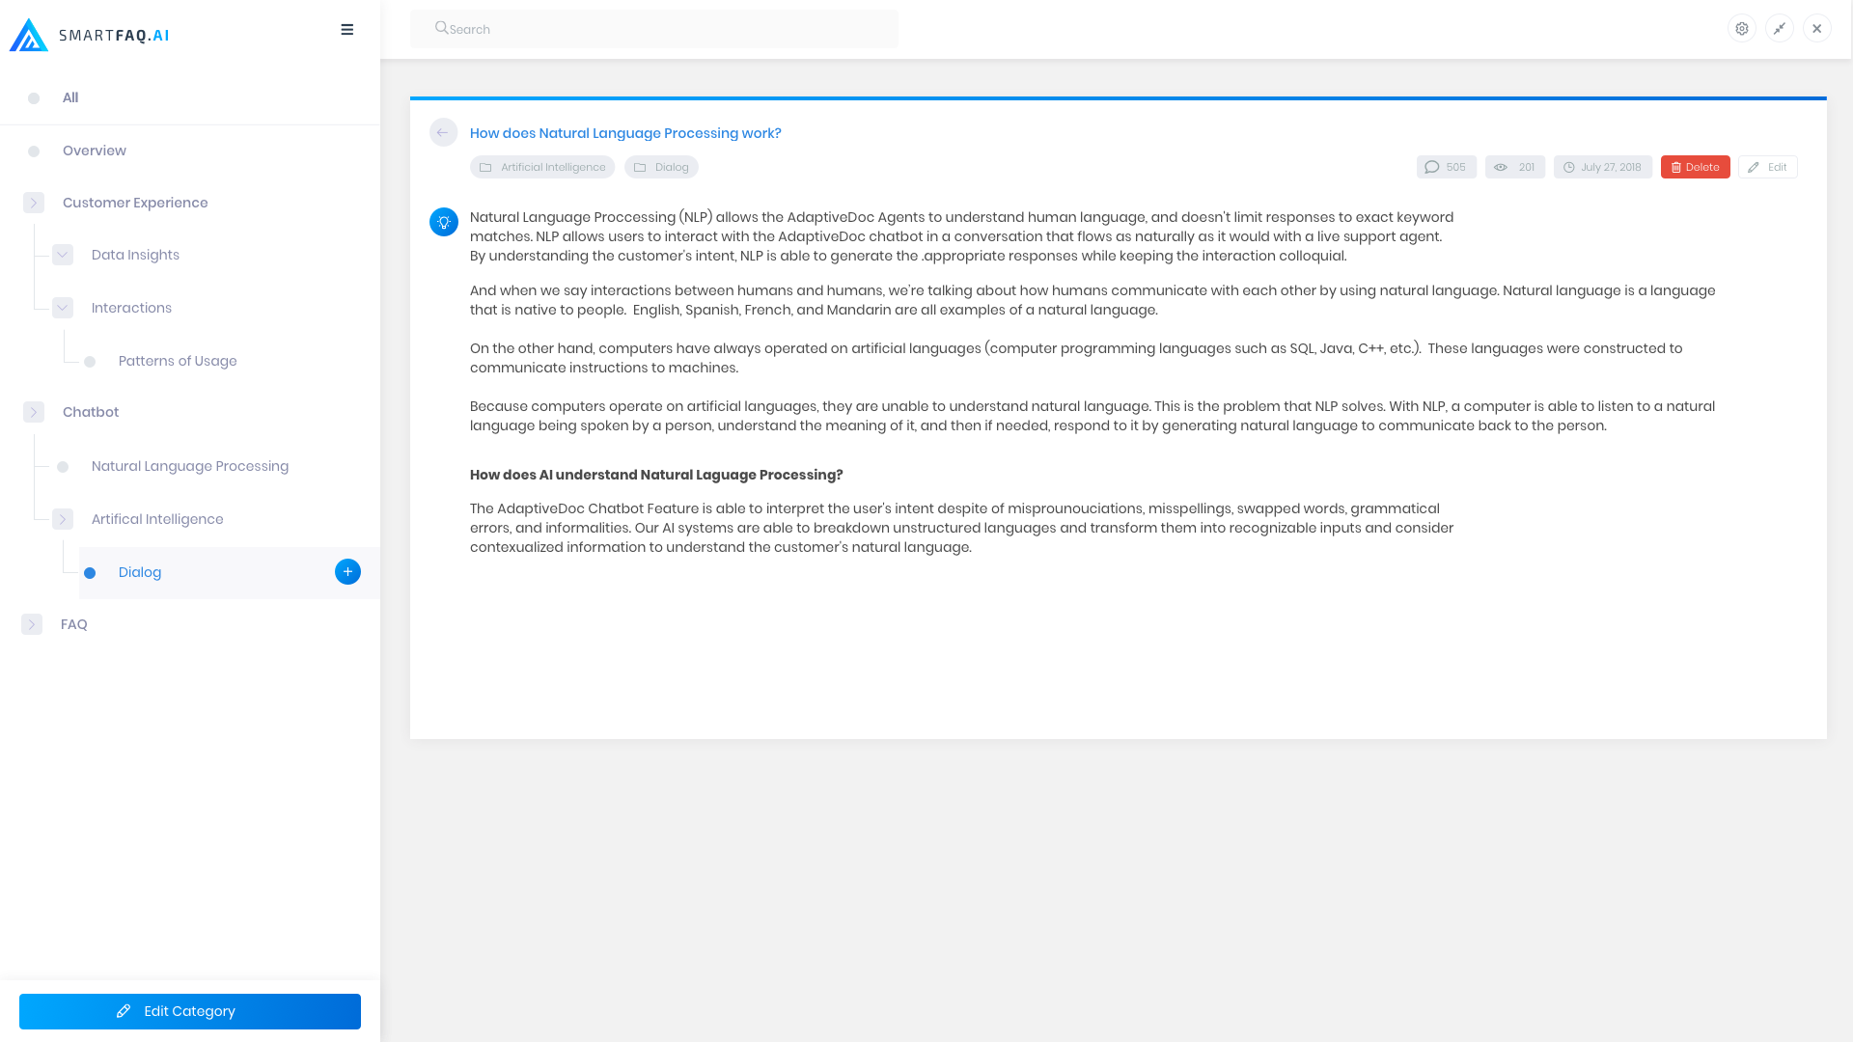
OVERVIEW
User can view the QnA Detail page and the counter statistics for the selected question
Super User is able to add, update, and delete QnA
Super user is able add alternative
questions to the selected QnA

Slide 11
SmartFAQ USE CASES
Use Case 1:
Organization A has over ten different software products developed by in-house tech teams plus many public-facing websites. All have static documentation or FAQ, which have been minimally updated over the years. In addition, the support knowledgebase can be scattered in multiple sites and formats. Product support rely on expensive product support personnel, with high turn-over rate and ever-climbing costs.
SOLUTION:
SmartFAQ can be embedded inside each of those software products and websites, with matching themes to each product. Support knowledgebase can now be centralized in one location, and is updated in real-time, in response to customer queries and requests. The integrated AI chatbot runs 24/7, answering most of customers’ questions, lessening the support burden on the support team. New support team members can be quickly trained on the product, as the knowledgebase is now centralized and can be smartly queried.

Slide 12
SmartFAQ USE CASES
Use Case 2:
Organization B recently released into Production a internally developed software application. Executive management has been surprised by the target users’ resistance to the application adoption. In addition, the support team is inundated by a huge volume of support requests, from simple print problem to complicated workflow algorithms.
SOLUTION:
SmartFAQ tracks users’ interactions in association with the supported application, including context-sensitive FAQ requests within each section of the application. These insights can help identify application areas where users have the most questions and requests. Custom dialogs to provide answers to more simple support requests via the AI Chatbot also alleviates pressure on the Application Support team, allowing them to concentrate on more complex support requests.

Slide 13
SmartFAQ USE CASES
Use Case 3:
Organization C needs to communicate on daily (periodic) basis its priorities (such as pushing certain products to sales team) or daily update of loan rate etc.
SOLUTION:
Certain designated super user of SmartFAQ can act as someone who updates these messages on the daily basis. All regular users of the software application, from a few to millions, can quickly do a daily query via voice or chat or the FAQ page to tune in the changing priorities or memos. In essence, SmartFAQ can act as a centralized memo distribution point.

